Slide 1
Contemporary Economic Issues ECON 204
Import Tariffs
Instructor: Muhebullah Karimzada
Notes:
If this PowerPoint presentation contains mathematical equations, you may need to check that your computer has the following installed:
1) MathType Plugin
2) Math Player (free versions available)
3) NVDA Reader (free versions available)

Slide 2
Questions to Consider
Why do governments sometimes apply a tariff on imported goods?
Why does the World Trade Organization try to reduce the use of tariffs?

Slide 3
Introduction (part 1)
During the U.S. presidential campaign of 2016, the Republican candidate Donald Trump said that he would apply a 45% tariff against imports from China.
President Trump did impose significant import tariffs on China in 2018–19.
The import tariff is an example of a trade policy, a government action meant to influence the amount of international trade.
Import tariffs are sometimes used for political and not economic reasons. This is called the political economy of tariffs.
Because the gains from trade are unevenly spread, industries and labor unions often feel that the government should do something to help limit their losses (or maximize their gains) from international trade.
That “something” is trade policy, which includes the use of import tariffs (taxes on imports), import quotas (quantity limits on imports), and export subsidies.

Slide 4
Introduction (part 2)
In this lecture, we begin our investigation of trade policies by focusing on the effects of tariffs in a perfectly competitive industry.
We explain the reasons why countries apply tariffs and the effects of these tariffs on the producers and consumers in the importing and exporting countries.

Slide 5
1) A Brief History of the World Trade Organization (part 1)
After World War II, the Allied countries met to discuss issues such as high trade barriers and unstable exchange rates.
In 1947 the General Agreement on Tariffs and Trade (GATT) was established to reduce barriers to trade between nations.
Some of the GATT’s main provisions are as follows:
A nation must extend the same tariffs to all trading partners that are GATT members.
Tariffs may be imposed in response to unfair trade practices such as dumping.
“Dumping” is defined as the sale of export goods at a price less than that charged at home, or at a price less than costs of production and shipping.

Slide 6
1) A Brief History of the World Trade Organization (part 2)
Some of the GATT’s main provisions are as follows:
Countries should not limit the quantity of goods and services that they import.
Countries should declare export subsidies provided to particular firms, sectors, or industries.
Countries can temporarily raise tariffs for certain products.

Slide 7
1) A Brief History of the World Trade Organization (part 3)
Some of the GATT’s main provisions are as follows:
6. The GATT recognizes the ability of blocs of countries to form two types of regional trade agreements:
Free-trade areas, in which a group of countries voluntarily agree to remove trade barriers between themselves
Customs unions, which are free-trade areas in which the countries also adopt identical tariffs between themselves and the rest of the world

Slide 8
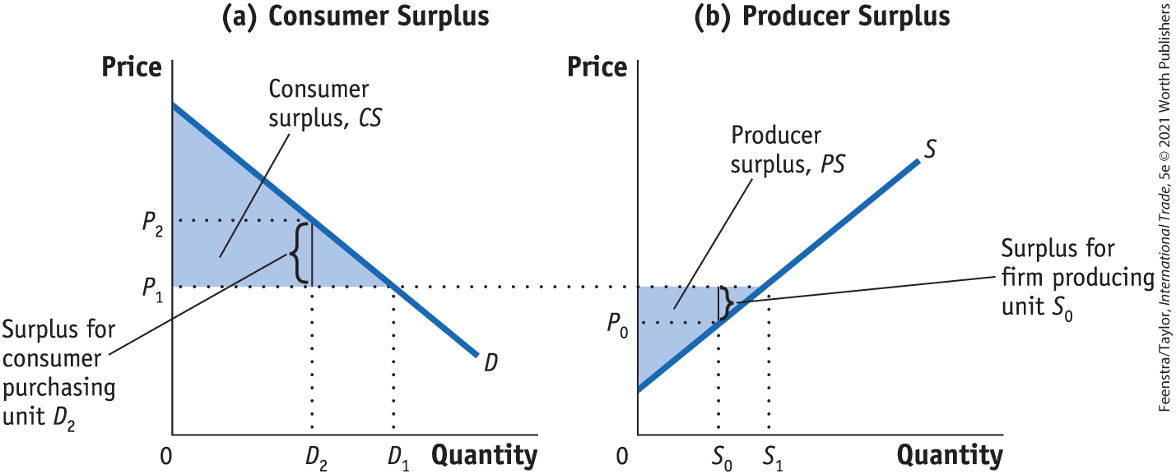
2) The Gains from Trade (part 1)
Consumer and Producer Surplus
FIGURE 1 (1 of 2) Consumer and Producer Surplus
In panel (a), the consumer surplus from purchasing quantity D₁ at price P₁ is the area below the demand curve and above that price. The consumer who purchases D₂ is willing to pay price P₂ but has to pay only P₁. The difference is the consumer surplus and represents the satisfaction of consumers over and above the amount paid.

Slide 9
2) The Gains from Trade (part 2)
Consumer and Producer Surplus
Figure 1 (2 of 2) Consumer and Producer Surplus
In panel (b), the producer surplus from supplying the quantity S₁ at the price P₁ is the area above the supply curve and below that price. The supplier who supplies unit S₀ has marginal costs of P₀ but sells it for P_{1.} The difference is the producer surplus and represents the return to fixed factors of production in the industry

Slide 10
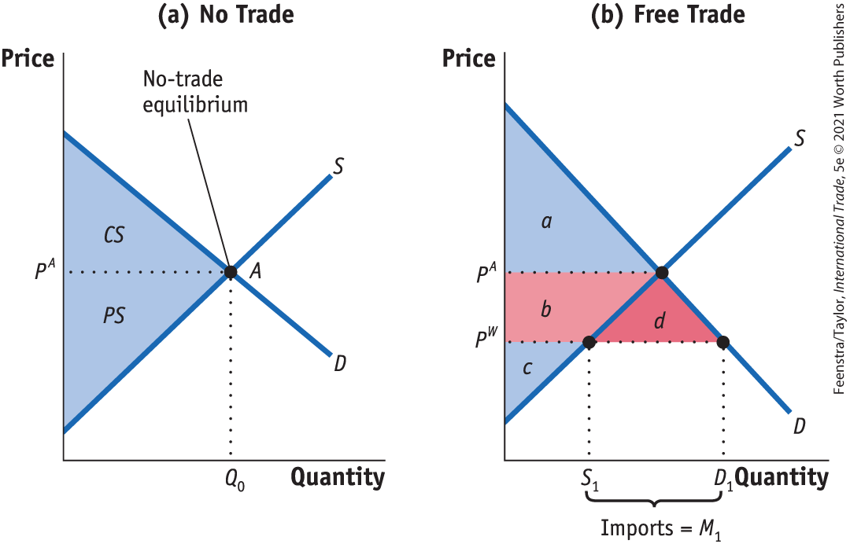
2) The Gains from Trade (part 3)
Home Welfare
No Trade, Free Trade for a Small Country, Gains from Trade
FIGURE 2
The Gains from Free Trade in Home With Home demand of D and supply of S, the no-trade equilibrium is at point A, at the price P^{A} producing Q₀.
With trade, the world price is P^{W}, so quantity demanded increases to D₁ and quantity supplied falls to S₁. Since quantity demanded exceeds quantity supplied, Home imports D₁ – S₁.
Consumer surplus increases by the area (b + d), and producer surplus falls by area b.
The gains from trade are measured by area d.
Rise in consumer surplus: +(b + d)
Fall in producer surplus: −b
Net effect on Home welfare: +d

Slide 11
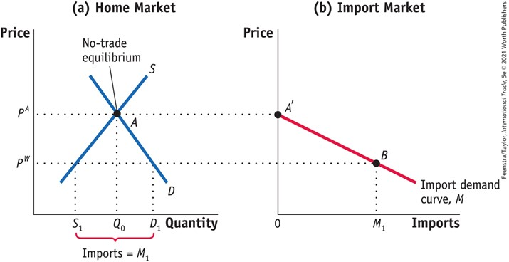
2) The Gains from Trade (part 4)
Home Import Demand Curve
FIGURE 3
Home Import Demand With Home demand of D and supply of S, the no-trade equilibrium is at point A, with the price P^{A} and import quantity Q₀.
Import demand at this price is zero, as shown by the point A' in panel (b).
At a lower world price of P^{W}, import demand is M₁ = D₁ – S₁, as shown by point B.
Joining up all points between A' and B, we obtain the import demand curve, M.
The import demand curve shows the relationship between the world price of a good and the quantity of imports demanded by Home consumers.

Slide 12
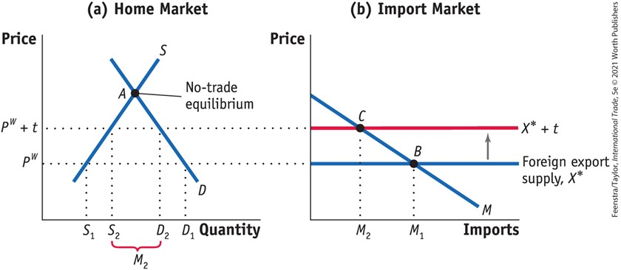
3) Import Tariffs for a Small Country (part 1)
Free Trade for a Small Country
FIGURE 4 (1 of 2) Tariff for a Small Country
Applying a tariff of t dollars will increase the import price from P^{W} to P^{W} + t. The domestic price of that good also rises to P^{W} + t. This price rise leads to an increase in Home supply from S₁ to S₂, and a decrease in Home demand from D₁ to D₂, in panel (a).

Slide 13
3) Import Tariffs for a Small Country (part 2)
Free Trade for a Small Country
FIGURE 4 (2 of 2) Tariff for a Small Country
Imports fall due to the tariff, from M₁ to M₂ in panel (b). As a result, the equilibrium shifts from point B to C.

Slide 14
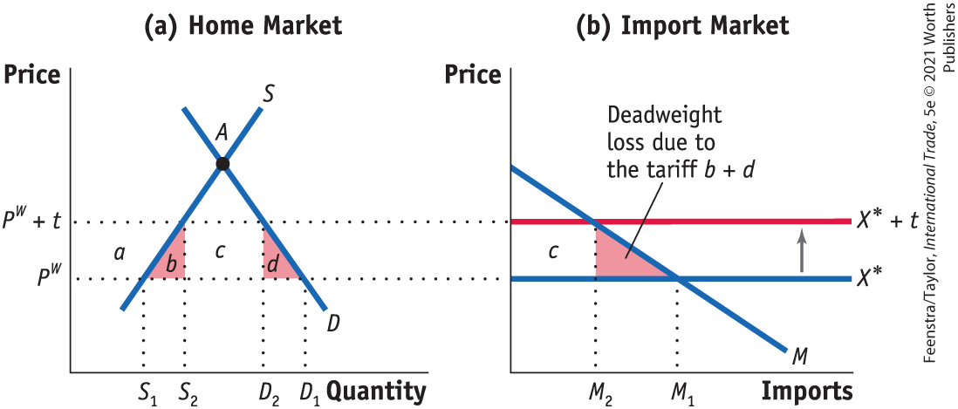
3) Import Tariffs for a Small Country (part 3)
Effect of the Tariff on Consumer Surplus, Producer Surplus, Government Revenue; Overall Effect of the Tariff on Welfare; Production Loss; Consumption Loss
FIGURE 5 (1 of 2)
The tariff increases the price from P^{W} to P^{W} + t. As a result, consumer surplus falls by (a + b + c + d). Producer surplus rises by area a, and government revenue increases by the area c.

Slide 15
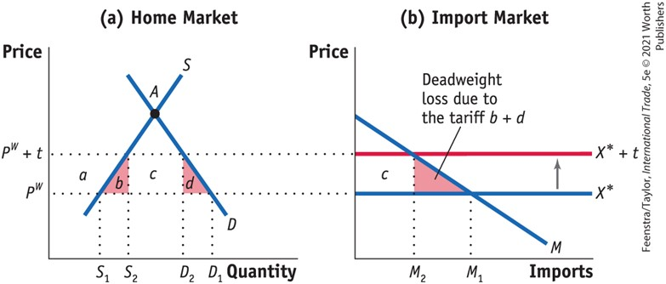
3) Import Tariffs for a Small Country (part 4)
Effect of the Tariff on Consumer Surplus, Producer Surplus, Government Revenue; Overall Effect of the Tariff on Welfare; Production Loss; Consumption Loss
FIGURE 5 (2 of 2)
Therefore, the net loss in welfare, the deadweight loss to Home, is (b + d), which is measured by the two triangles b and d in panel (a) or the single (combined) triangle b + d in panel (b).
The triangle (b + d) is a deadweight loss, or a loss that is not offset by a gain elsewhere in the economy.
Fall in consumer surplus: −(a + b + c + d)
Rise in producer surplus: +a
Rise in government revenue: +c
Net effect on Home welfare: −(b + d)

Slide 16
3) Import Tariffs for a Small Country (part 5)
Effect of the Tariff on Consumer Surplus, Producer Surplus, Government Revenue; Overall Effect of the Tariff on Welfare; Production Loss; Consumption Loss
The deadweight loss, triangles (b + d ), has the following interpretation:
The triangle b equals the increase in marginal costs for the extra units produced and can be interpreted as the production loss (or the efficiency loss) due to producing at marginal cost above the world price.

Slide 17
3) Import Tariffs for a Small Country (part 6)
Effect of the Tariff on Consumer Surplus, Producer Surplus, Government Revenue; Overall Effect of the Tariff on Welfare; Production Loss; Consumption Loss
The triangle d can be interpreted as the drop in consumer surplus for those individuals who are no longer able to consume the units between D1 and D2 because of the higher price. We refer to this drop in consumer surplus as the consumption loss for the economy.

Slide 18
U.S. Tariffs on Steel, 2002-03 (part 1)
TABLE 1
U.S. ITC Recommended and Actual Tariffs for Steel Shown here are the tariffs recommended by the U.S. International Trade Commission for steel imports in 2002, and the actual tariffs that were applied in 2002.
Product Category | Tariff Recommended by the U.S. ITC (for 2002, %) | Actual U.S. Tariff (used in 2002, %)
Carbon and Alloy Flat Products
Slab | 20 | 30
Flat products | 20 | 30
Tin mill products | U* | 30
Carbon and Alloy Long Products
Hot-rolled bar | 20 | 30
Cold-finished bar | 20 | 30
Rebar | 10 | 15
Carbon and Alloy Tubular Products
Tubular products | ?** | 15
Alloy fittings and flanges | 13 | 13
Stainless and Tool Steel Products
Stainless steel bar | 15 | 15
Stainless steel rod | ?** | 15
Stainless steel wire | U* | 8

Slide 19
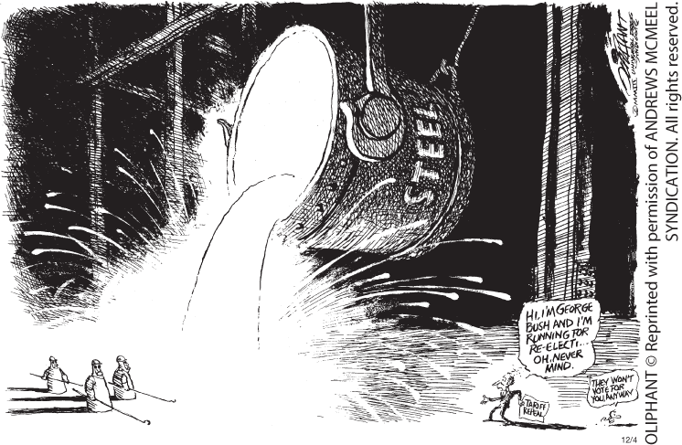

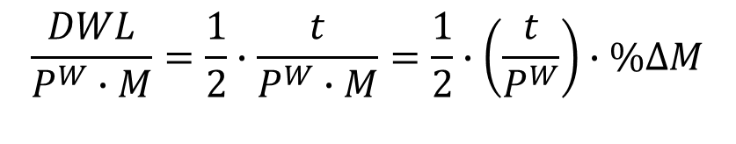
U.S. Tariffs on Steel, 2002-03 (part 2)
Deadweight Loss Due to the Steel Tariff
$$DWL=\frac{1}{2}∙t∙∆M$$
The deadweight loss relative to the value of imports equals:
$$\frac{DWL}{P^{W}∙M}=\frac{1}{2}∙\frac{t}{P^{W}∙M}=\frac{1}{2}∙\left(\frac{t}{P^{W}}\right)∙\%∆M$$

Slide 20
U.S. Tariffs on Steel, 2002-03 (part 3)
Response of the European Countries
The WTO has a dispute settlement procedure under which countries can bring their complaint and have it evaluated.
The countries in the European Union (EU) took action by bringing the case to the WTO. The WTO ruling entitled the European Union and other countries to retaliate against the United States by imposing tariffs of their own against U.S. exports.
The use of tariffs by an importer can easily lead to a response by exporters and a tariff war.

Slide 21
U.S. and Foreign Tariffs Under President Trump, 2018–19 (part 1)
TABLE 2
U.S. and Foreign Tariffs, 2018‒19 Panel (a) of this table shows the tariffs applied on U.S. imports by the administration of President Trump during 2018‒19. Panel (b) shows the tariffs applied on U.S. exports by foreign countries in retaliation for the U.S. import tariffs.
Product or Country | 2017 Tariff (%) | First Date of Tariff* | 2018 or 2019 Tariff** (%) | Trade Law
Washing machines | 1.3 | February 7, 2018 | 20–50 | Section 201
Solar panels | 0 | February 7, 2018 | 30 | Section 201
Steel | 0 | March–June, 2018 | 25 | Section 232
Aluminum | 2 | March–June, 2018 | 12 | Section 232
China (many products) | 1.2–3.4 | July 2018–October 2019 | 13.4–26.2 | Section 301
Retaliating Country | 2017 Tariff (%) | First Date of Tariff* | 2018 or 2019** Tariff (%) | In Response to U.S. Tariffs on
China | 7.8 | April 2018–October 2019 | 22.7 | Steel, aluminum, other products
Mexico | 9.6 | June 5, 2018 | 28 | Steel, aluminum
Turkey | 9.7 | June 21, 2018 | 31.8 | Steel, aluminum
European Union | 3.9 | June 22, 2018 | 29.2 | Steel, aluminum
Canada | 2.1 | July 1, 2018 | 20.2 | Steel, aluminum
Russia | 5.2 | August 6, 2018 | 36.8 | Steel, aluminum
India | n.a. | June 15, 2019 | 10–70 | Steel, aluminum

Slide 22
U.S. and Foreign Tariffs Under President Trump, 2018–19 (part 2)
TABLE 8-3
Welfare Impact of 2018 and 2019 U.S. Tariffs Panel (a) shows the welfare impact of the 2018 U.S. tariffs, and the initial 10% tariffs applied to $200 billion of U.S. imports from China in September 2018. Panel (b) extends those results to include the increase in the U.S. tariffs on China during 2019.
 | (1) | (2) | (3)
 | Consumer Loss from Higher Import Prices | Tariff Revenue | Deadweight Loss
Annual cost ($ billions) | 52.8 | 36.0 | 16.8
Annual cost per household ($) | 414 | 282 | 132
 | (1) | (2) | (3)
 | Consumer Loss from Higher Import Prices | Tariff Revenue | Deadweight Loss
Annual cost ($ billions) | 106 | 26.9 | 79.1
Annual cost per household ($) | 831 | 211 | 620

Slide 23
The Political Economy of Tariffs
If a tariff always leads to a deadweight loss of a small importing country, why then do the United States and many other countries use tariffs as part of their trade policies?
Politics. The tariff benefits Home producers, so if the government cares more about the producer surplus than consumer surplus, it might decide to use the tariff despite the deadweight loss and consumer costs.
Because benefits are concentrated and costs are spread more thinly and widely across the country, the industry has the greater political power to persuade the government to use the tariffs.

Slide 24
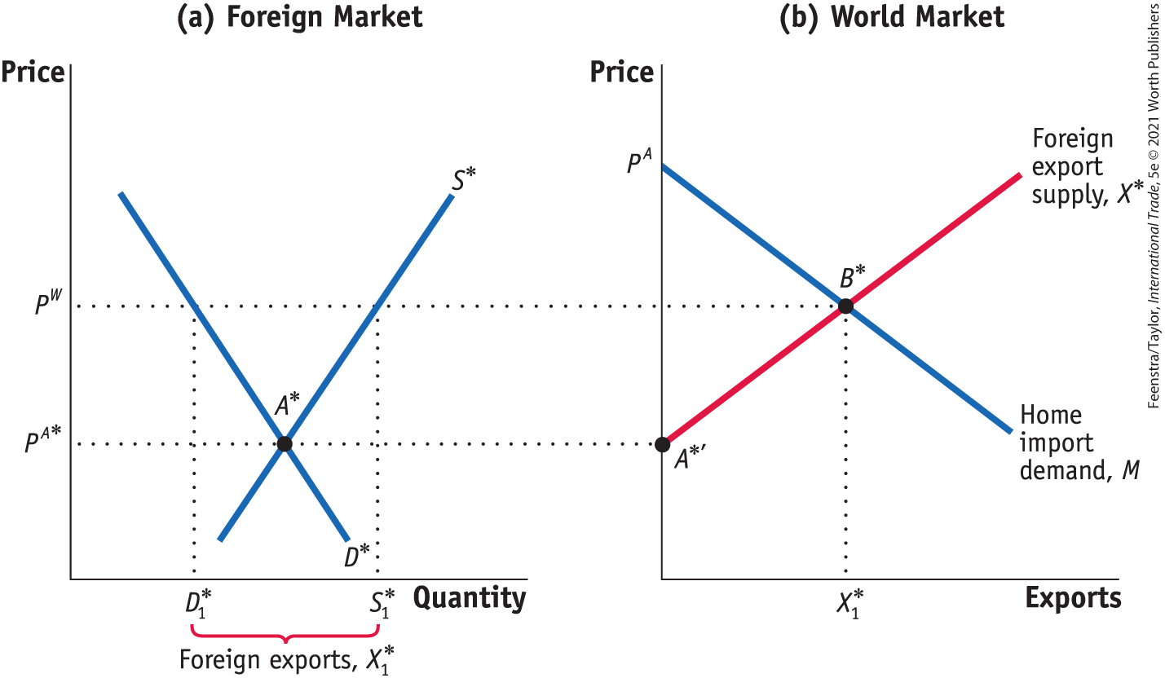
4) Import Tariffs for a Large Country (part 1)
Foreign Export Supply
FIGURE 6 (1 of 3) Foreign Export Supply
In panel (a), with Foreign demand of D* and Foreign supply of S*, the no-trade equilibrium in Foreign is at point A*, with the price of P^{A*}.
At this price, the Foreign market is in equilibrium and Foreign exports are zero—point A* in panel (a) and point A*′ in panel (b), respectively.

Slide 25
4) Import Tariffs for a Large Country (part 2)
Foreign Export Supply
FIGURE 6 (2 of 3) Foreign Export Supply
When the world price, P^{W}, is higher than Foreign’s no-trade price, the quantity supplied by Foreign, S*₁, exceeds the quantity demanded by Foreign, D*₁, and Foreign exports X*₁ = S*₁ – D*₁.
In panel (b), joining up points A*′ and B*, we obtain the upward-sloping export supply curve X*.

Slide 26
4) Import Tariffs for a Large Country (part 3)
Foreign Export Supply
FIGURE 6 (3 of 3) Foreign Export Supply
With the Home import demand of M, the world equilibrium is at point B*, with the price P^{W}.

Slide 27
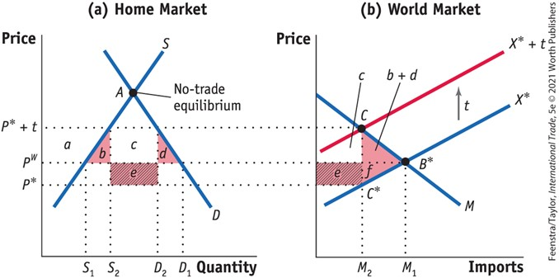
4) Import Tariffs for a Large Country (part 4)
Effect of the Tariff
Terms of Trade, Home’s Welfare, Foreign and World Welfare
FIGURE 7
Tariff for a Large Country
The tariff shifts up the export supply curve from X* to X*+ t.
As a result, the Home price increases from P^{W} to P* + t, and the Foreign price falls from P^{W} to P*.
The deadweight loss at Home is the area of the triangle (b + d), and Home also has a terms-of-trade gain of area e.
Foreign loses the area (e + f), so the net loss in world welfare is the triangle (b + d + f). Area e is a measure of the terms-of-trade gain for the importer.
Fall in consumer surplus: −(a + b + c + d)
Rise in producer surplus: +a
Rise in government revenue: +(c + e)
Net effect on Home welfare: e − (b + d)

Slide 28
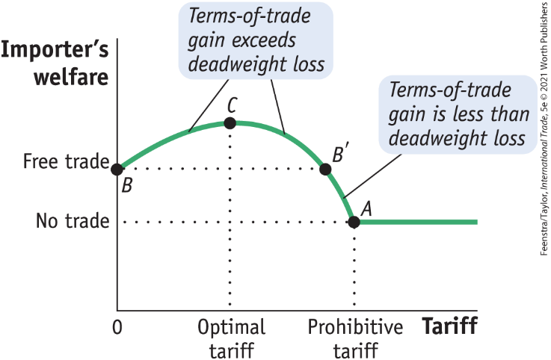

4) Import Tariffs for a Large Country (part 5)
Foreign Export Supply
Optimal Tariff for a Large Importing Country
FIGURE 8
Tariffs and Welfare for a Large Country For a large importing country, a tariff initially increases the importer’s welfare because the terms-of-trade gain exceeds the deadweight loss. So the importer’s welfare rises from point B. Welfare continues to rise until the tariff is at its optimal level (point C). After that, welfare falls. If the tariff is too large (greater than at B′), then welfare will fall below the free-trade level. For a prohibitive tariff, with no imports at all, the importer’s welfare will be at the no-trade level, at point A.
Optimal Tariff Formula The formula depends on the elasticity of Foreign export supply, which we call E*_{X}:
$$Optimal tariff=\frac{1}{{E^{∗}}_{X}}$$

Slide 29
Conclusions (part 1)
A tariff on imports is the most commonly used trade policy tool.
Assuming a small country, when we add together all the effects of a tariff—the drop in consumer surplus, the gain in producer surplus, and the government revenue collected—we still get a net loss for the importing country, which is a deadweight loss resulting from the tariff.
Why are tariffs used then?
They are an easy way for governments to raise revenue.
Politics. The government might care more about protecting firms than avoiding losses for consumers.
The small-country assumption may not hold in practice.

Slide 30
Conclusions (part 2)
For a large country, when we add up the drop in consumer surplus, the gain in producer surplus, and the government revenue collected, it is possible for a small tariff to generate welfare gains for the importing country.
However, in this case, any gain for the importer comes at the expense of the foreign exporters. The drop in the exporter’s welfare due to the tariff is greater than the gain in the importer’s welfare. Therefore, the world loses overall because of the tariff.

